Slide 1

Business Plan
LifePulse
Group member: Chengxuan Li
Ruixian Zhong
Notes:
大家好！今天我们非常高兴为大家展示 LifePulse，这是一款能够让用户在家进行血液检测并提供个性化健康报告的移动健康应用。我们的团队成员包括李承轩和钟瑞贤。

Slide 2
01
APP Introduction
Market Analysis
Contents
02
03
Financial Plan
04
Validation

Slide 3
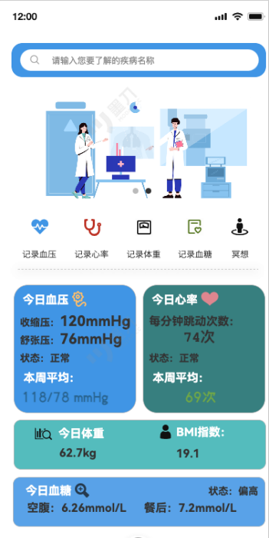
01
APP Introduction
LifePulse is an AI-powered mobile app for at-home blood testing and personalized health reports.
PART ONE

Slide 4




Social Problem
Patients face long wait times, complicated processes for test results, and a lack of clear guidance, especially first-time patients who struggle to find reliable healthcare information.
Rural hospitals often lack staff or funding, leading to insufficient services and uneven distribution of healthcare resources across regions.
Poor data integration between departments hinders effective patient management, causing duplication of information and medical errors, reducing healthcare efficiency.
Notes:
1. 患者面临着冗长的等待时间和复杂的医疗测试流程，尤其是第一次就医的患者，他们往往缺乏获取可靠医疗信息的渠道。这种情况下，患者不仅会在复杂的医疗服务流程中晕头转向，甚至可能延误必要的治疗。为了减轻患者的焦虑，医疗系统需要简化流程、提供清晰的指导，并通过数字化工具帮助患者快速获取医疗信息和测试结果。
2. 农村医院经常面临人手不足或资金短缺的问题，导致医疗服务质量差、资源分布不均。许多农村地区缺乏合格的医疗人员和先进的设备，严重影响了这些地区的医疗效率。
3. 医疗部门之间的数据整合不充分，导致患者管理效率低下。由于信息重复录入和不一致的医疗记录，容易出现医疗错误，进而影响治疗效果。

Slide 5
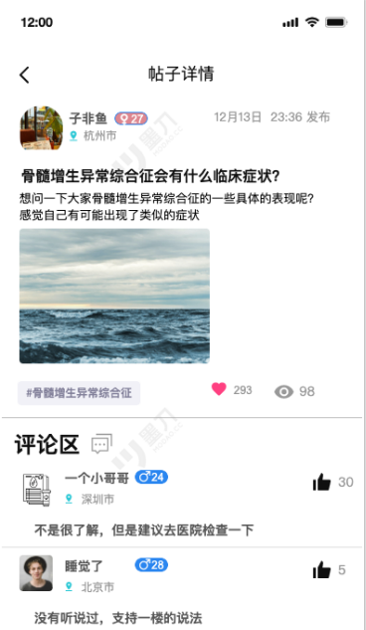
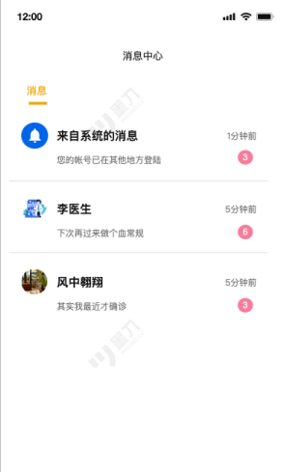
Brief Function
Blood Testing
Daily Health Metrics Tracking
Uses Yolov5+Lora model for highly accurate, quick diagnostics.
Enables users to monitor daily health metrics such
as blood pressure, weight, and more.
Health Reports
Health Communication Hub
Uses expert system for integrating user testing data and medical history to automatically identify potential health issues and provide preliminary assessments
Provides a platform for users to connect with healthcare professionals for advice and support.
Notes:
在这一部分，我将向大家介绍 LifePulse 的四个核心功能，分别是血液检测、健康报告、日常健康指标追踪以及健康沟通平台。
首先，LifePulse 使用 Yolov5+Lora 模型，实现了高度准确且快速的血液诊断。这项功能允许用户在家中进行血液检测，并能在短时间内获得结果。这不仅方便了那些行动不便或时间紧张的人群，还能帮助他们减少前往医院的频率，从而节省时间和精力。
接下来是健康报告功能。LifePulse 通过专家系统，将用户的检测数据和医疗历史进行整合，自动识别潜在的健康问题，并提供初步评估。
第三个功能是日常健康指标追踪。LifePulse 可以帮助用户监测诸如血压、体重等日常健康指标。我们会提供一个页面展示这些数据指标，帮助用户更好地了解自己的健康状态，并在必要时采取措施进行调整。
最后，LifePulse 提供了一个健康沟通平台，使用户能够与医疗专业人员联系，获得建议和支持。这一平台为用户提供了一个及时沟通的渠道，尤其在他们有健康疑问或需要进一步诊疗时，能够获得专业的指导。这不仅让用户感到更为安心，还可以促进医生和患者之间的有效互动。

Slide 6
02
Market Analysis
LifePulse serves individuals and healthcare institutions, addressing the increasing demand for remote health services.
PART TWO

Slide 7
Macro Environment Analysis
political
Economic
PEST
social
Technology
Notes:
首先我们会对我们APP的外部环境进行分析，在这里我们运用PEST模型，分别是政策，经济，社会和技术四个层面来进行分析。
政策层面：国家"十四五"规划明确强调了加强健康服务，推动远程监测和智慧医疗服务的发展，支持个人健康的实时监测和评估。这些政策提供了一个有利的市场环境，推动智能医疗产品的发展。
经济层面：传统的血液检测方法依赖人工计算和操作，导致检测结果的周转时间较长（通常1-2小时），并且存在潜在的人为错误。这种低效率不仅影响了患者的体验，还延误了治疗。
社会层面：随着社会节奏逐渐加快，消费者对医疗的便利性越来越追求，远程医疗和数字健康应运而生。
技术层面：当前的图像识别算法在血液检测中的精确度仍然不足，导致测试结果的可靠性较低，依然需要人工验证。

Slide 8

Target User Group
We hope this app can not only provide individuals with convenient, at-home health solutions, helping them better manage their health through technology and clear reports, but also assist healthcare institutions in streamlining their workflows, reducing staff burden, and improving efficiency. By offering a platform that integrates advanced health tools, we aim to empower individuals with proactive health management while enabling institutions to make quicker, data-driven clinical decisions.
Notes:
我们这个APP的目标群体不仅仅是对血液检测有需求的普通个体，还有同样追求检测效率提升的医疗机构。

Slide 9




Products of the same type on the market
Noom
Buoy
Sensely
Huawei Sports Health
So what's the advantage of our App compared to what's on the market?
Notes:
那么我们这款软件的市场竞争力如何呢？我们先从市场找到几款与我们的APP功能有相似之处的APP，分别是专注于行为改变的减肥和健康管理应用，通过心理辅导帮助用户改善生活方式的NOOM，利用AI技术帮助用户自我监控的BUOY和Sensely，还有提供全面的运动和健康数据跟踪，帮助用户进行日常健康管理的华为运动健康。

Slide 10


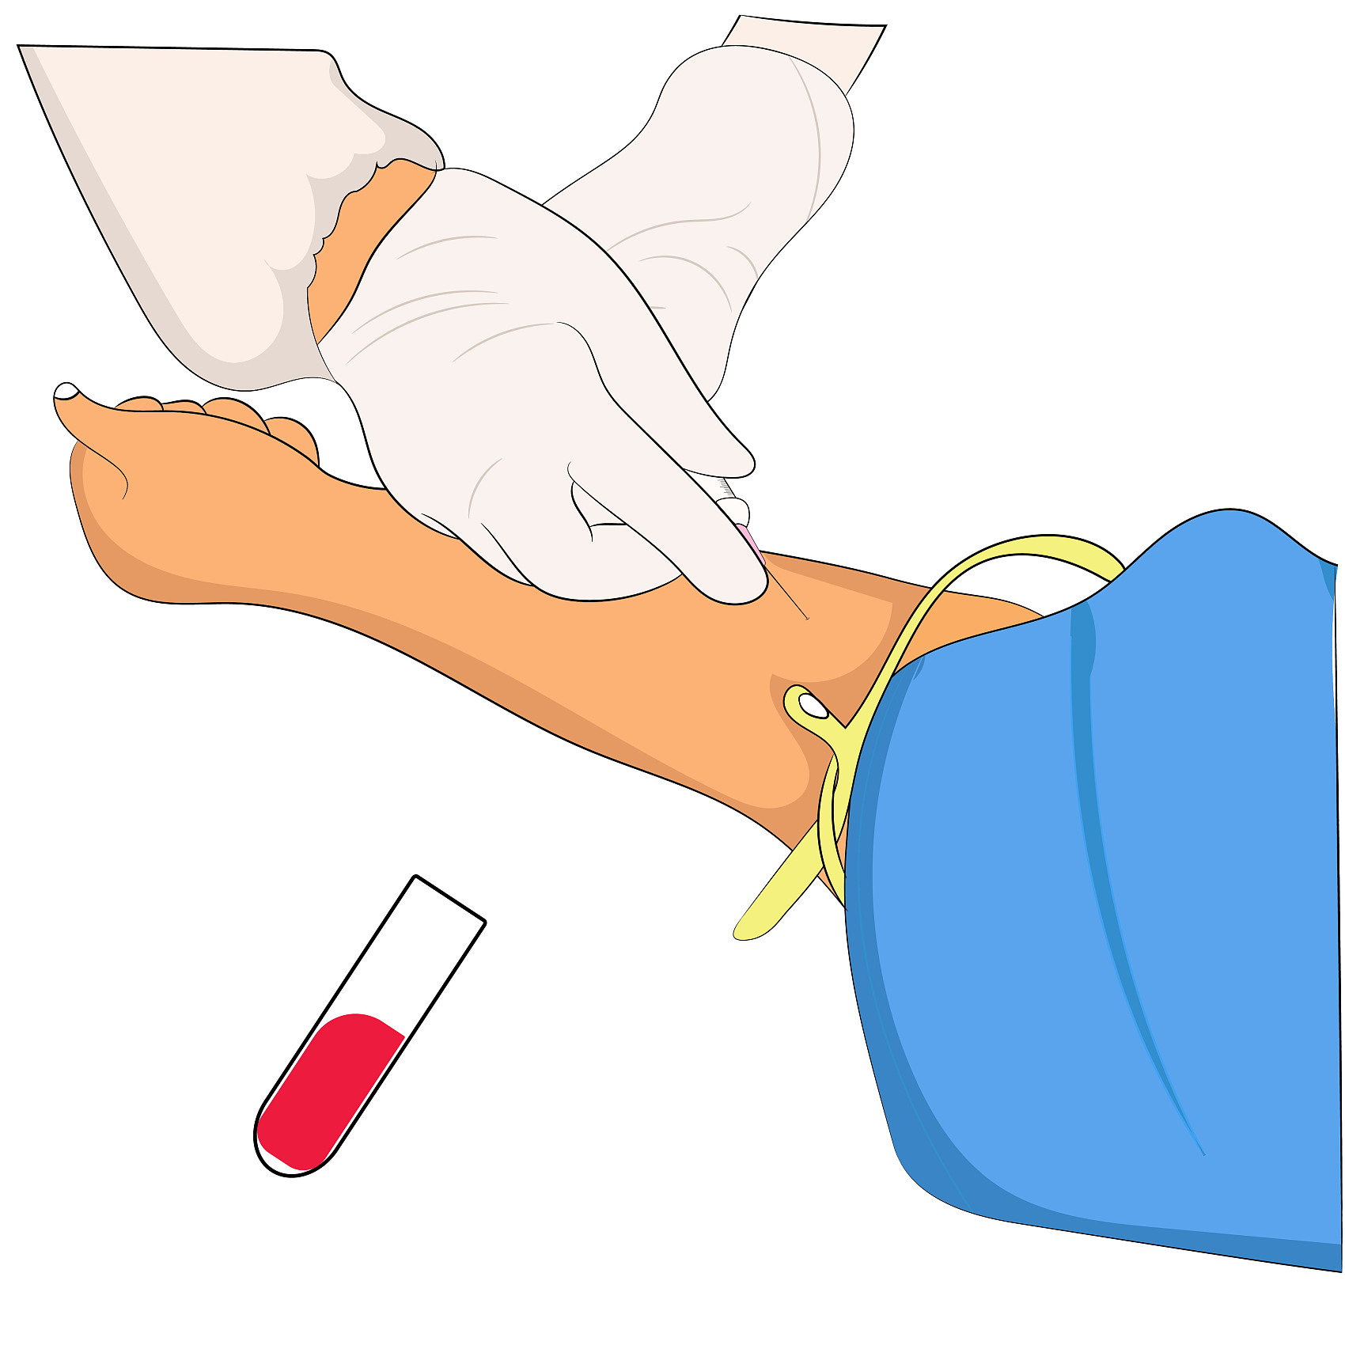
Competitive Analysis
At-Home Sampling Service
Unlike other health management apps, LifePulse focuses on providing convenient at-home blood sampling and instant detection, eliminating the need for hospital or clinic visits.
Specialized
Blood Health
Monitoring
Community
Hospital-Friendly
While many similar apps do not specialize in blood health monitoring, LifePulse is dedicated to this core function, offering more in-depth and professional blood health analysis.
LifePulse is designed to help community hospitals and individual users access high-quality blood analysis services at a lower cost.
Notes:
对比起上述的四款软件，我们这款APP融合了他们的长处，并拓展了一些他们没有的功能。我们的app专注于血液检测，并致力于为普通用户提供居家检测的便捷性，最后还会给用户与专业机构沟通的窗口，极大减少了用户自我健康检测的盲目。

Slide 11
03
Financial Plan
LifePulse will use free versions for feedback and small-fee features to cover operational costs.
PART THREE

Slide 12
Work Planning
Alpha
Version
Beta Version
Trial Version
RTM Version
GA Version
Notes:
我们会从五个版本阶段来讲述我们的商业计划，分别是Alpha版本，Beta版本，试用版本，正式发布版本和一般可用版本

Slide 13
Work Planning
Alpha
Version
Beta Version
Pricing: Provided for free, focus on collecting more user feedback.
Goal: Reach 5,000 downloads and use user feedback to improve the app’s features and performance.
Sales Focus: Ensure user retention through feedback collection and lay the foundation for introducing paid features in future versions.
Notes:
在Alpha和Beta版本阶段，我们的应用将免费提供，主要目标是收集用户的反馈。我们的目标是达到5000次下载，通过这些反馈不断优化应用的功能和性能。这个阶段，我们更加注重用户的增长和参与度，而不是追求财务上的回报。

Slide 14
Work Planning
Alpha
Version
Beta Version
Trial Version
Pricing: Potential introduction of optional small-fee features (e.g., more detailed health reports) to help cover operational costs.
Goal: Test user acceptance of paid features and explore the app’s revenue potential.
Sales Focus: Continue focusing on user growth while testing the market’s response to paid features.
Notes:
在试用阶段，我们将可能引入一些可选的、小额付费功能，例如更详细的健康报告，帮助覆盖运营成本。我们的目标是测试用户对这些付费功能的接受度，并探索应用的收入潜力。同时，我们会继续专注于用户增长，并测试市场对付费功能的反馈。

Slide 15
Work Planning
Alpha
Version
Beta Version
Trial Version
RTM Version
Pricing: Adjust the pricing and content of paid features based on user feedback and data from the trial version.
Goal: Reach 10,000 active users and begin generating revenue from paid features to cover operational costs.
Sales Focus: Increase the number of active users while promoting the use of paid features.
Notes:
在正式发布版本阶段，我们将根据试用版收集到的用户反馈和数据，调整付费功能的定价和内容。我们的目标是达到一万名活跃用户，并通过付费功能开始产生收入以覆盖运营成本。在这个阶段，我们会一方面增加活跃用户的数量，另一方面大力推广付费功能的使用。

Slide 16
Work Planning
Alpha
Version
Beta Version
Trial Version
RTM Version
GA Version
Pricing: Established paid features, with free basic services still available.
Goal: Ensure the app is mature and stable based on feedback and data from previous versions, and expand promotion to a broader community and market.
Sales Focus: Maintain user growth and engagement while scaling revenue from paid features.
Notes:
在一般可用版本阶段，我们将推出已确定的付费功能，同时保留免费基础服务。我们的目标是确保应用基于之前版本的反馈和数据变得成熟且稳定，并且扩大推广范围，覆盖更广泛的社区和市场。在这一阶段，我们将继续保持用户的增长和参与度，同时扩大付费功能的收入规模。

Slide 17
04
Validation
User testing and feedback will refine the app and validate its effectiveness before broader release.
PART FOUR
Notes:
产品上线后，我们会对产品进行一个验证，帮助我们找到产品的不足，进而进行产品的迭代更新。我们会从用户使用，市场调查和软件自带反馈三种方法进行验证

Slide 18

User Testing and Usability
Beta Testing
We will engage 100 diverse users aged 18-65, tracking metrics such as daily active users (target 70%) and gathering qualitative feedback through surveys.
Usability Testing
20 participants will perform key tasks (e.g., registering, submitting samples), aiming for 90% task success and completion times under 3 minutes.
Notes:
用户方面，首先我们将在Beta测试阶段邀请100名年龄在18到65岁之间的用户，重点跟踪每日活跃用户的指标，目标是达到70%的活跃率。
在可用性测试阶段，我们将邀请20名参与者执行一些关键任务，比如注册和提交样本。我们的目标是实现90%的任务成功率，并确保任务的完成时间不超过3分钟。

Slide 19

Market Research
Questionnaires
A/B Testing
Social Media
We will design a brief survey with 10 questions, targeting potential users to gather opinions on app features, design aesthetics, and pricing models.
We will implement A/B testing on at least two different versions of the app’s onboarding process to evaluate user reactions by measuring metrics like completion rates and user satisfaction
We will create and share engaging content on platforms like Wechat, Xiaohongshu and Bilibili, aiming for at least 1,000 interactions per post to encourage user feedback and discussions about our app.
Notes:
在市场调研方面，我们将通过三种方式来了解用户需求和市场反馈。首先，我们会设计一个包含10个问题的简短问卷，针对潜在用户收集关于应用功能、设计美学和定价模型的意见。其次，我们会进行A/B测试，测试至少两个不同版本的用户引导流程，评估用户的反应，通过完成率和用户满意度等指标进行衡量。最后，我们会在社交媒体平台如微信、小红书和哔哩哔哩上发布有吸引力的内容，目标是每篇内容至少获得1000次互动，以促进用户反馈和讨论。

Slide 20



Feedback and Iteration
User Feedback Mechanism
Implement an in-app feedback system with a 48-hour response time, fostering user trust and engagement.
Regular Updates
Schedule quarterly updates incorporating feedback and market trends, ensuring the app stays relevant and user-friendly.
Notes:
在反馈与迭代方面，首先我们将实施一个应用内反馈系统，确保用户的问题能够在48小时内得到回复，这样可以增强用户的信任感和参与度。其次，我们计划每季度进行一次更新，这些更新将结合用户反馈和市场趋势，确保我们的应用始终保持相关性，并且用户体验友好。通过这种方式，我们可以持续改进应用，满足用户的需求。

Slide 21
Thank You
感谢大家观看
"The greatest wealth is health." — Virgil
Notes:
以上就是我们APP的内容，感谢大家观看！

